Slide 1
ENGINEERING GRAPHICS 1
CLASS 2:PROJECTION OF LINES
(SHEET 2)

Slide 2
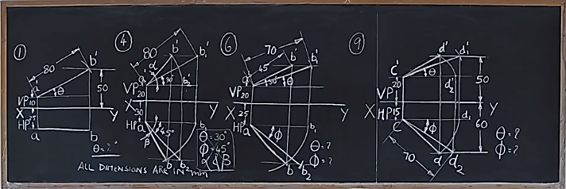

Slide 3
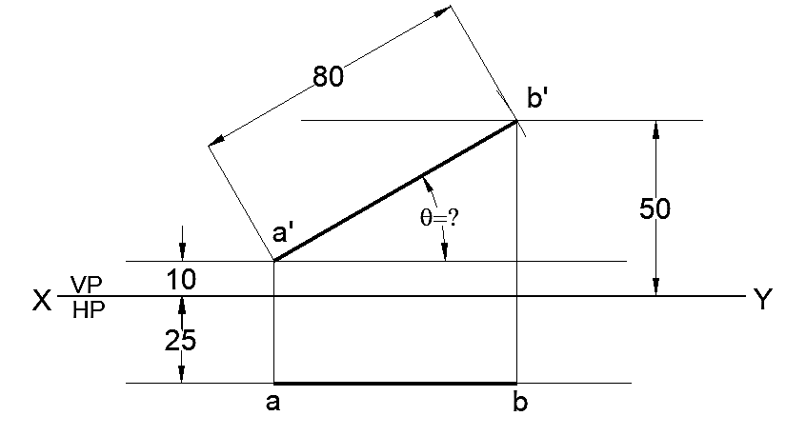
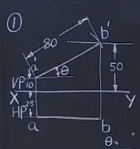
QUESTION BANK: PROJECTION OF LINES - PROBLEM 1
A line 80 mm long is parallel to & 25 mm in front of VP. One of its ends is 10 mm above HP while the other end is 50 mm above HP. Draw its projections and find its inclination with HP.
ALL DIMENTIONS ARE IN mm

Slide 4
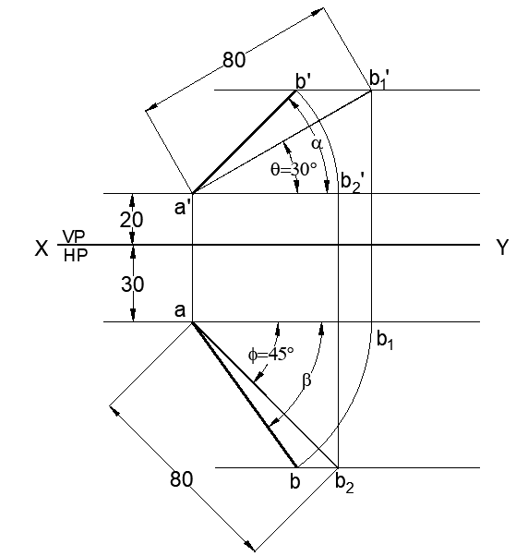
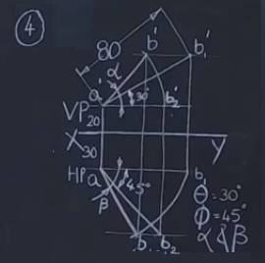
QUESTION BANK: PROJECTION OF LINES - PROBLEM 4
A line AB 80 mm long, has its end A 20 mm above HP and 30 mm in front of VP. It is inclined at 30 ° to HP and 45 ° to VP. Draw the projections of the line.
ALL DIMENTIONS ARE IN mm

Slide 5
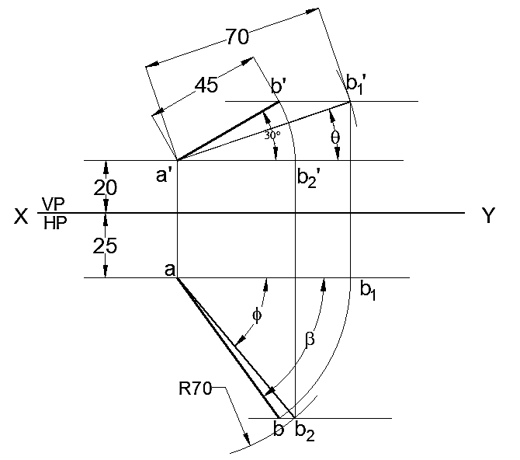
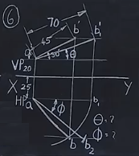
QUESTION BANK: PROJECTION OF LINES - PROBLEM 6
The front view of a line AB of length 70 mm is inclined at 30 ° to XY line and measures 45 mm. The end A is 20 mm above HP and 25 mm in front of VP. Draw the projections of the line and determine its inclination with HP and VP.
ALL DIMENTIONS ARE IN mm

Slide 6
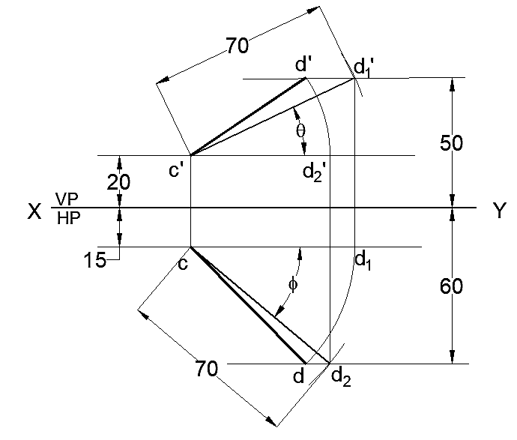
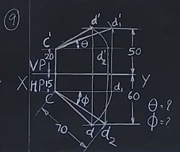
QUESTION BANK: PROJECTION OF LINES - PROBLEM 9
A line CD measuring 70 mm has its end C, 15 mm in front of VP and 20 mm above HP and the other end D is 60 mm in front of VP and 50 mm above HP. Draw the projections of the line and determine its inclination with both the reference planes of projection.
ALL DIMENTIONS ARE IN mm

Slide 7
Problem 1: Inclination of the line with HP = 30°
Problem 6: Inclination of the line with HP = 19°
Inclination of the line with VP = 50°
Problem 9: Inclination of the line with HP = 25°
Inclination of the line with VP = 40°

